Slide 2
VOCATIONAL JOURNEYS OF AUSTRALIA
The Marist Association
Of
St Marcellin Champagnat
“Sharing in Mary’s work of bringing Christ – life to birth” (WFTR, 11)

Slide 3
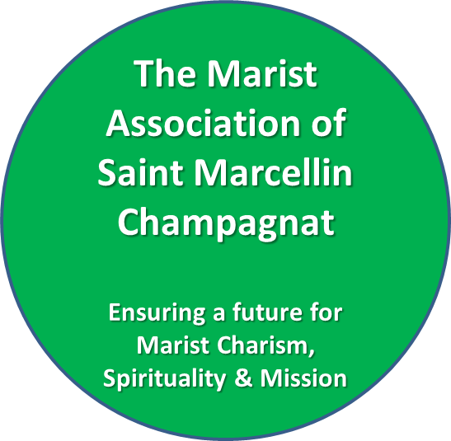
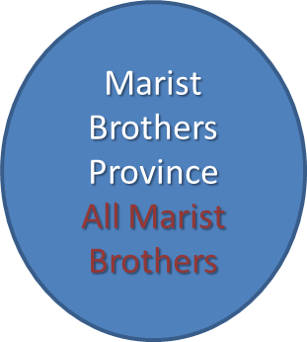
Australian Marist Community
All who are in some way connected to Marist life and mission… All people working in, or otherwise engaged with Marist ministries across Australia and Young Marists

Slide 4
The Marist Association: Members
Anyone with a Marist heart!
Br
Mr
Mrs
Mst
Miss
Fr
Sr
Interested in growing the life and action of the spiritual family that flows from Marcellin Champagnat and the early community of brothers – a new tent!

Slide 5
The Marist Association Overview: Purpose
A framework for fostering relationships and belonging between Marists (Brother and Lay) so as to:
Continue to bring hope to young people we serve.
Build communion between those who are passionate about Marist spirituality, life and mission.
Share responsibility for Marist life and mission.
Grow as a spiritual family.
Create vitality and viability for Marist mission and life.
Deepen our spiritual lives in a Marist way.

Slide 6
The Marist Association: Life and Mission
People who promote and support Marist ministries:
schools (Marist Schools Australia)
youth ministry (Marist Youth Ministry)
youth welfare(Marist Youth Care)
solidarity (Marist Solidarity)
An Association Council, will be the formal body that carries the canonical responsibility of these ministries.

Slide 7
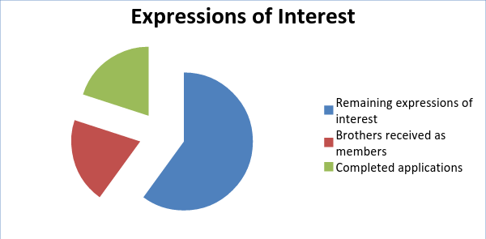
The Marist Association: Affirmations
Energy.
Questions and Conversations.
Rapid growth.

Slide 8
The Marist Association: Challenges
Develop appropriate personal formation.
Remain faithful to our mission and spirituality.
Uphold an all-embracing and life-giving culture.
Develop an engaging, active presence and voice in the Australian Catholic Church.

Slide 9
The Marist Association: Questions…

