Slide 1
PROVINCIAL PROJECT
LAY ANIMATORS COURSE

Slide 2
WHY A PROJECT?
Formalized road map indicating the direction we are going over the next years and how to get there.
Sets direction and priorities
Points to specific results to be achieved and establishes a course of action for achieving
Gets everyone on the same page
LAY ANIMATORS COURSE

Slide 3
APPRECIATIVE INQUIRY
Ap-pre’ci-ate, v., 1. valuing; the act of recognizing the best in people or the world around us; affirming past and present strengths, successes, and potentials;
In-quire’, v., 1. the act of exploration and discovery. 2. To ask questions; to be open to seeing new potentials and possibilities.
LAY ANIMATORS COURSE

Slide 4
“The world isn’t a problem to be solved but it’s a miracle to be embraced.
If we can cultivate this awareness everyday, and begin to raise awareness of what is it that gives life to human systems, we might be able to help that process of building more and better life.”
David Cooperrider
“El mundo no es un problema que hay que resolver, sino un milagro que se debe abrazar.
Si pudiéramos cultivar esa percepción cada día, y empezáramos a ser más conscientes de lo que da vida a los sistemas humanos, seríamos capaces de contribuir a ese proceso de construir más y mejor vida.”
David Cooperrider

Slide 6
In every society, organization or group, something works.
1
En toda sociedad, organización o grupo, hay algo que funciona

Slide 7
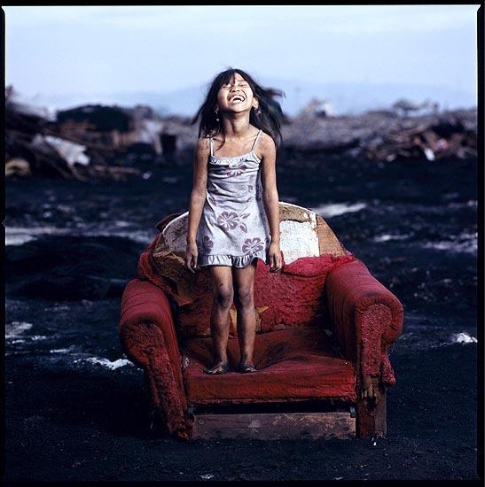
2

Slide 8
What we focus on becomes our reality
2
Aquello en lo cual nos centramos se convierte en nuestra realidad

Slide 9
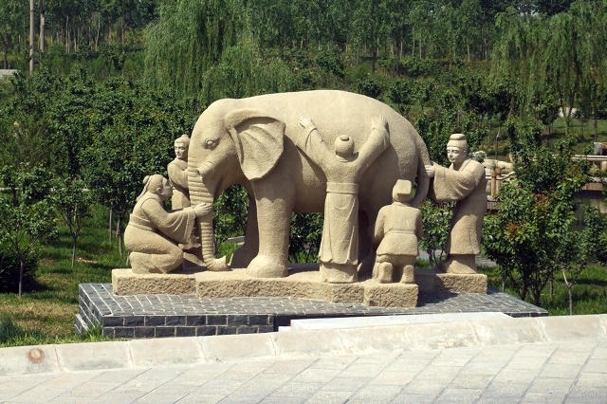
Reality is created in the moment, and there are multiple realities
3
La realidad se crea en el momento, y las realidades son múltiples

Slide 10
The act of asking questions of an organization or group influences the group in some way
4
El hecho de que una organización o grupo se haga preguntas, influye
de alguna manera en el grupo

Slide 11
People have more confidence and comfort to journey to the future (the unknown) when they carry forward parts of the past (the known)
5
Las personas se sienten más seguras y cómodas
en su camino hacia el futuro (lo desconocido)
cuando llevan consigo algo del pasado (lo conocido)

Slide 12
If we carry parts of the past forward, they should be what is best about the past
6
Si llevamos con nosotros elementos del pasado, tendrían que ser lo mejor del pasado

Slide 13
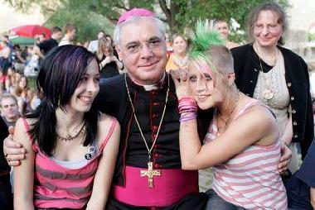
It is important to value differences
7
Es importante valorar las diferencias

Slide 14
The language we use creates our reality
8
El lenguaje que usamos crea nuestra realidad

Slide 15
APPRECIATIVE INQUIRY
Appreciative Inquiry is the exploration of what gives life to human systems when they function best.
LAY ANIMATORS COURSE

Slide 16
APPRECIATIVE INQUIRY
Appreciate “What is” (What gives life?)
Imagine “What Might Be”
Determine “What Should Be”
Create “What Will Be”
LAY ANIMATORS COURSE

Slide 17
Affirmative topic – G. Chapter XXI
We see our Marist future as a communion of people in the charism of Champagnat, where our specific vocations will be mutually enriching.
Nous envisageons notre avenir mariste comme une communion de personnes dans le charisme de Champagnat, où nos vocations respectives s’enrichiront mutuellement.
Vemos o nosso futuro marista como comunhão de pessoas no carisma de Champagnat, no qual se enriquecem mutuamente as nossas vocações específicas.
Contemplamos nuestro futuro marista como una comunión de personas en el carisma de Champagnat, donde nuestras vocaciones específicas se enriquecerán mutuamente.
LAY ANIMATORS COURSE

Slide 18
If you want to build a ship, don’t drum up the men to gather wood, divide the work, and give orders. Instead, teach them to yearn for the vast and endless sea.
Se você quer construir um navio, não chame as pessoas para juntar madeira ou atribua-lhes tarefas e trabalho, mas sim ensine-os a desejar a infinita imensidão do oceano.
A. Saint-Exupery
LAY ANIMATORS COURSE

Slide 19
Appreciative Inquiry – Four D
DISCOVERY “What gives life?” Storytelling – the best of what is.
DREAM “What could be?” Imagining the future.
DESIGN “What should be?” Provocative propositions.
DESTINY “What will we do?” Delivering performance.
LAY ANIMATORS COURSE

Slide 20
1
DISCOVERY
“What gives life?” Storytelling – the best of what is.
LAY ANIMATORS COURSE

Slide 21
1
DISCOVERY
What has been your most authentic experience regarding the communion of laity and brothers within the charism? Describe your experience. What did you receive from it? In what way has it been enriching?
When was the last time you felt truly MARIST? Why did you feel that way? Describe what you felt.
What has been your best experience of touching the hearts of children and young people together with other Marists? What made this possible?
What is the best sign you have found in your Province regarding this new relationship pointed out by the General Chapter?
LAY ANIMATORS COURSE

Slide 22
2
DREAM
“What could be?”
Imagining the future
LAY ANIMATORS COURSE

Slide 23
2
DREAM
Vision exercise: 2030.
Express your vision through a drawing, or design a newspaper cover about Marist life.
LAY ANIMATORS COURSE

Slide 24
3
DESIGN
“What should be?”
Provocative propositions.
LAY ANIMATORS COURSE

Slide 25
DESIGN
Provocative propositions :
They are powerful, visionary statements.
A challenging proposal clearly defines what it wants and how it wants it. It is a possibility statement, which bridges what ‘actually is’ and what ‘could be’.
3
LAY ANIMATORS COURSE

Slide 26
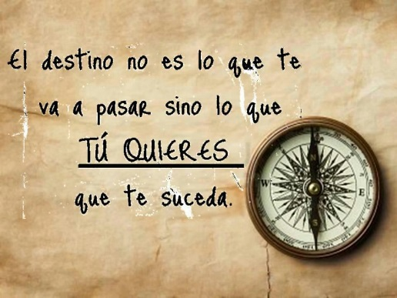
4
DESTINY
“What will we do?”
Delivering performance.
LAY ANIMATORS COURSE

Slide 27
DESIGN
Give a short name to each proposal.
What steps would be necessary to implement each proposal?
What would be your commitment in order to make each proposal successful?
4
LAY ANIMATORS COURSE

Slide 28
1st June - Monday
REGIONS
Present your “dreams” and your “provocative propositions”
Which are the common elements you can point out?
Which have been the difficulties when working out the Project?
LAY ANIMATORS COURSE

Slide 29
LAY ANIMATORS COURSE

