Slide 2
Revision Constitutions
International communities
Lay Marists
New models

Slide 3
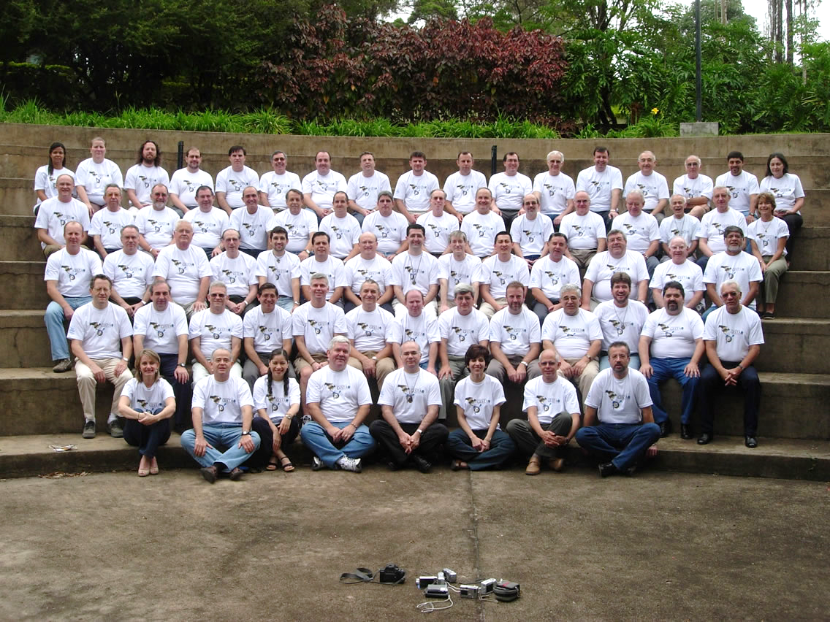
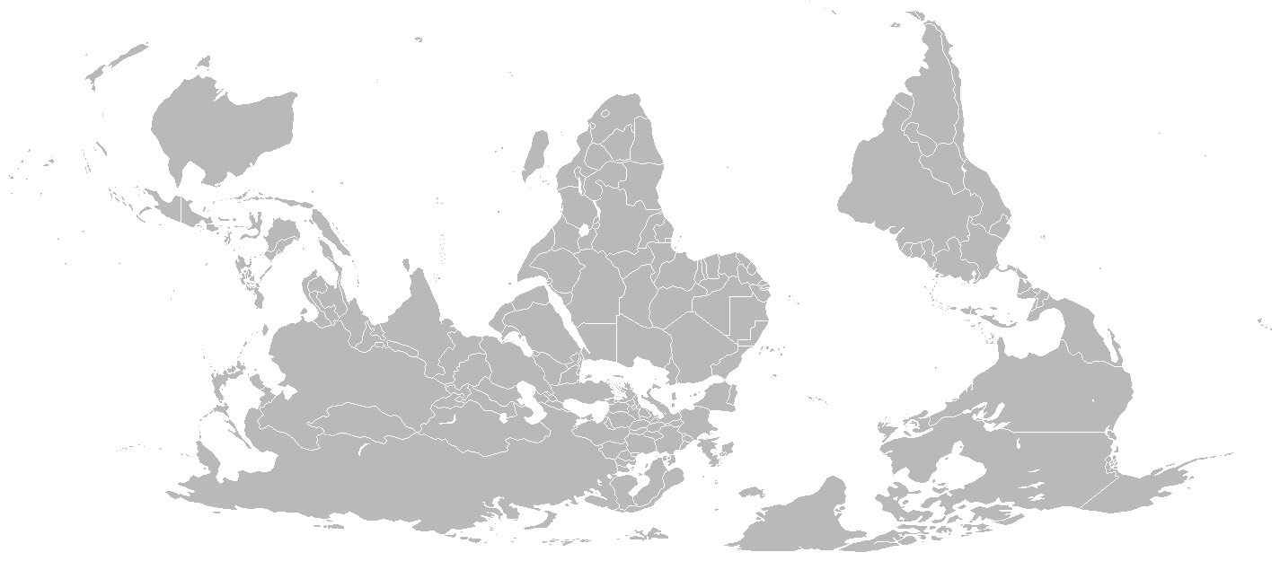
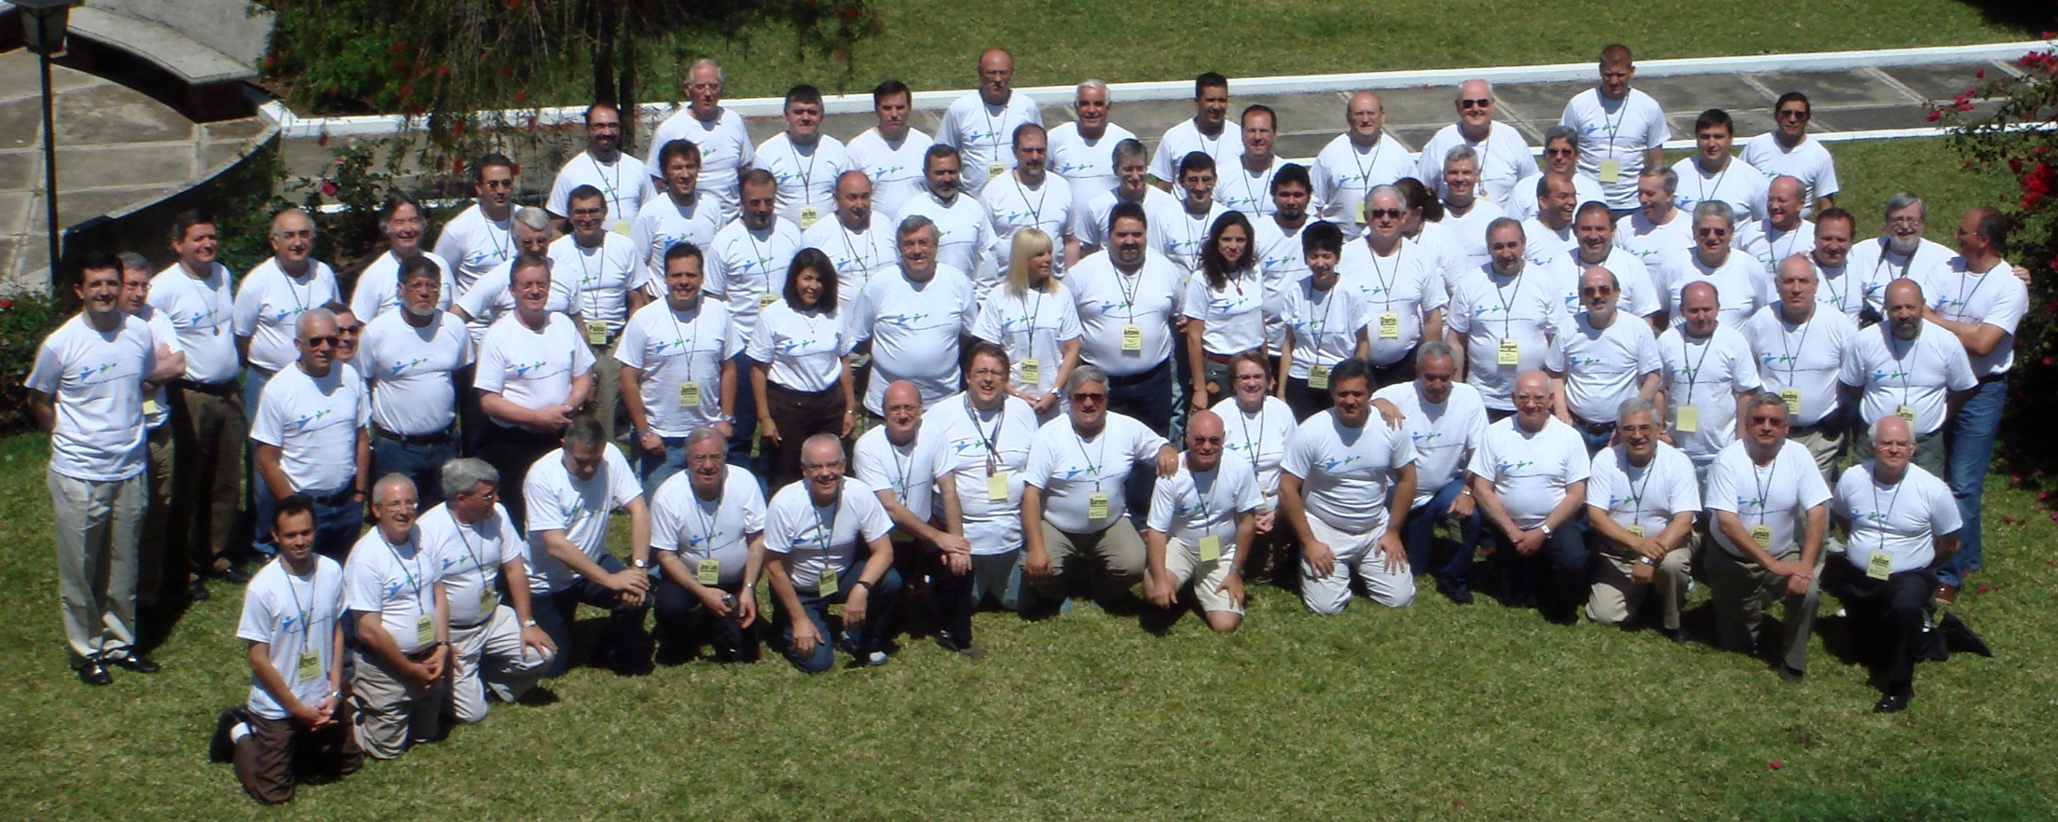
2006
2009

Slide 4
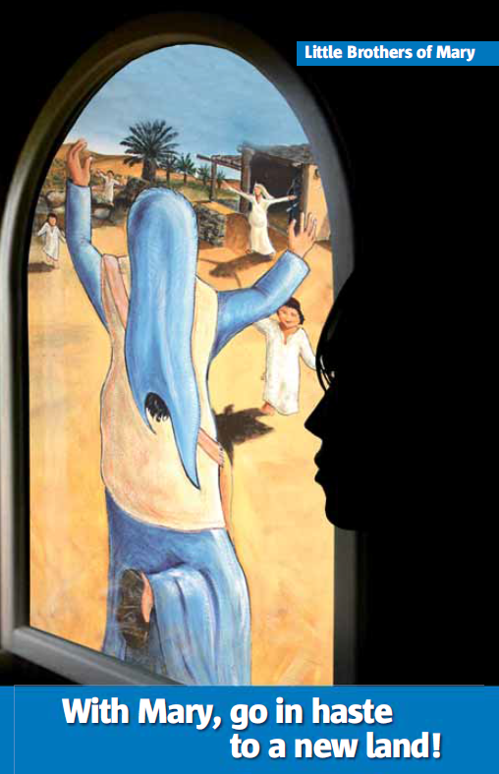

Slide 5
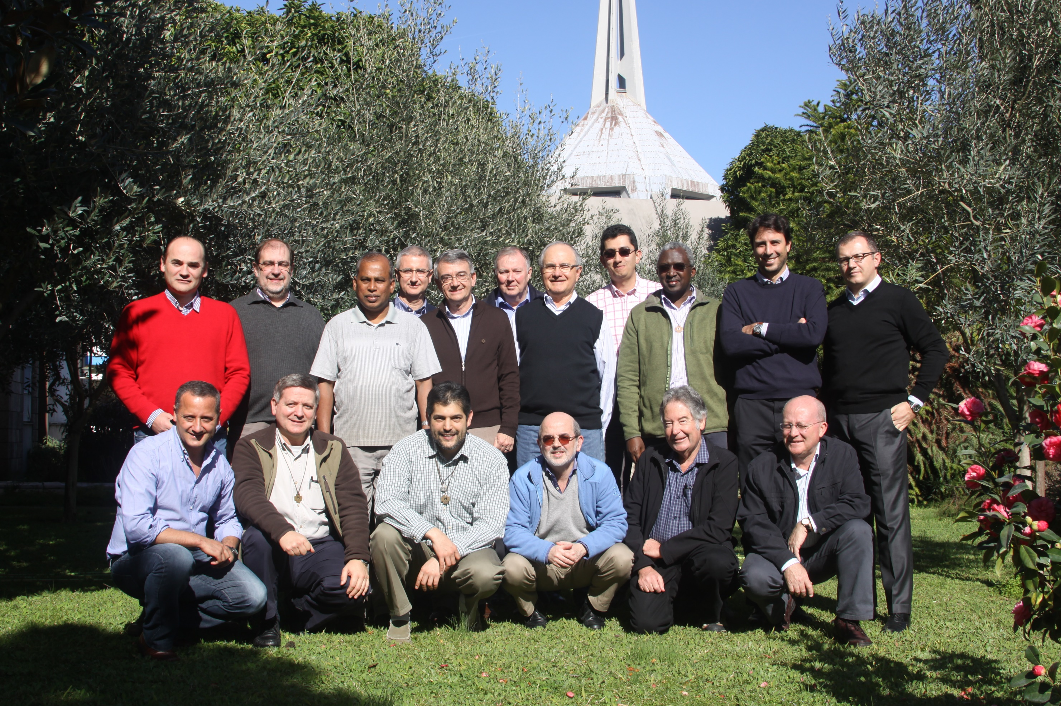
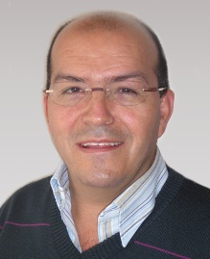

Slide 6
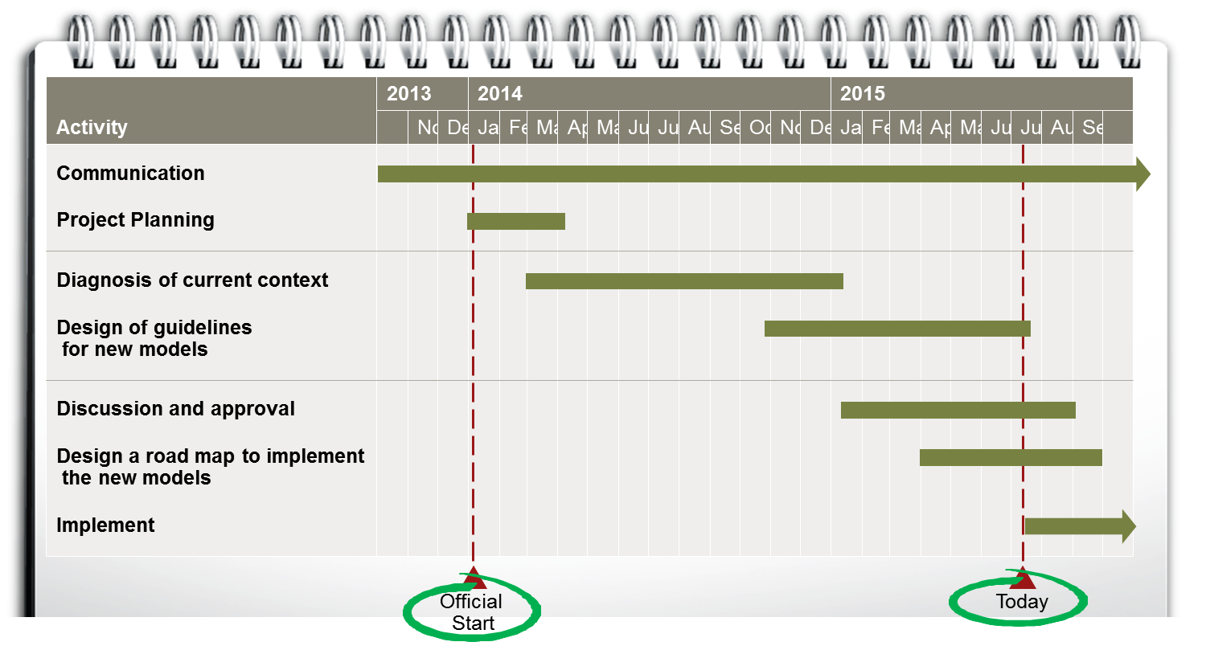

Slide 7
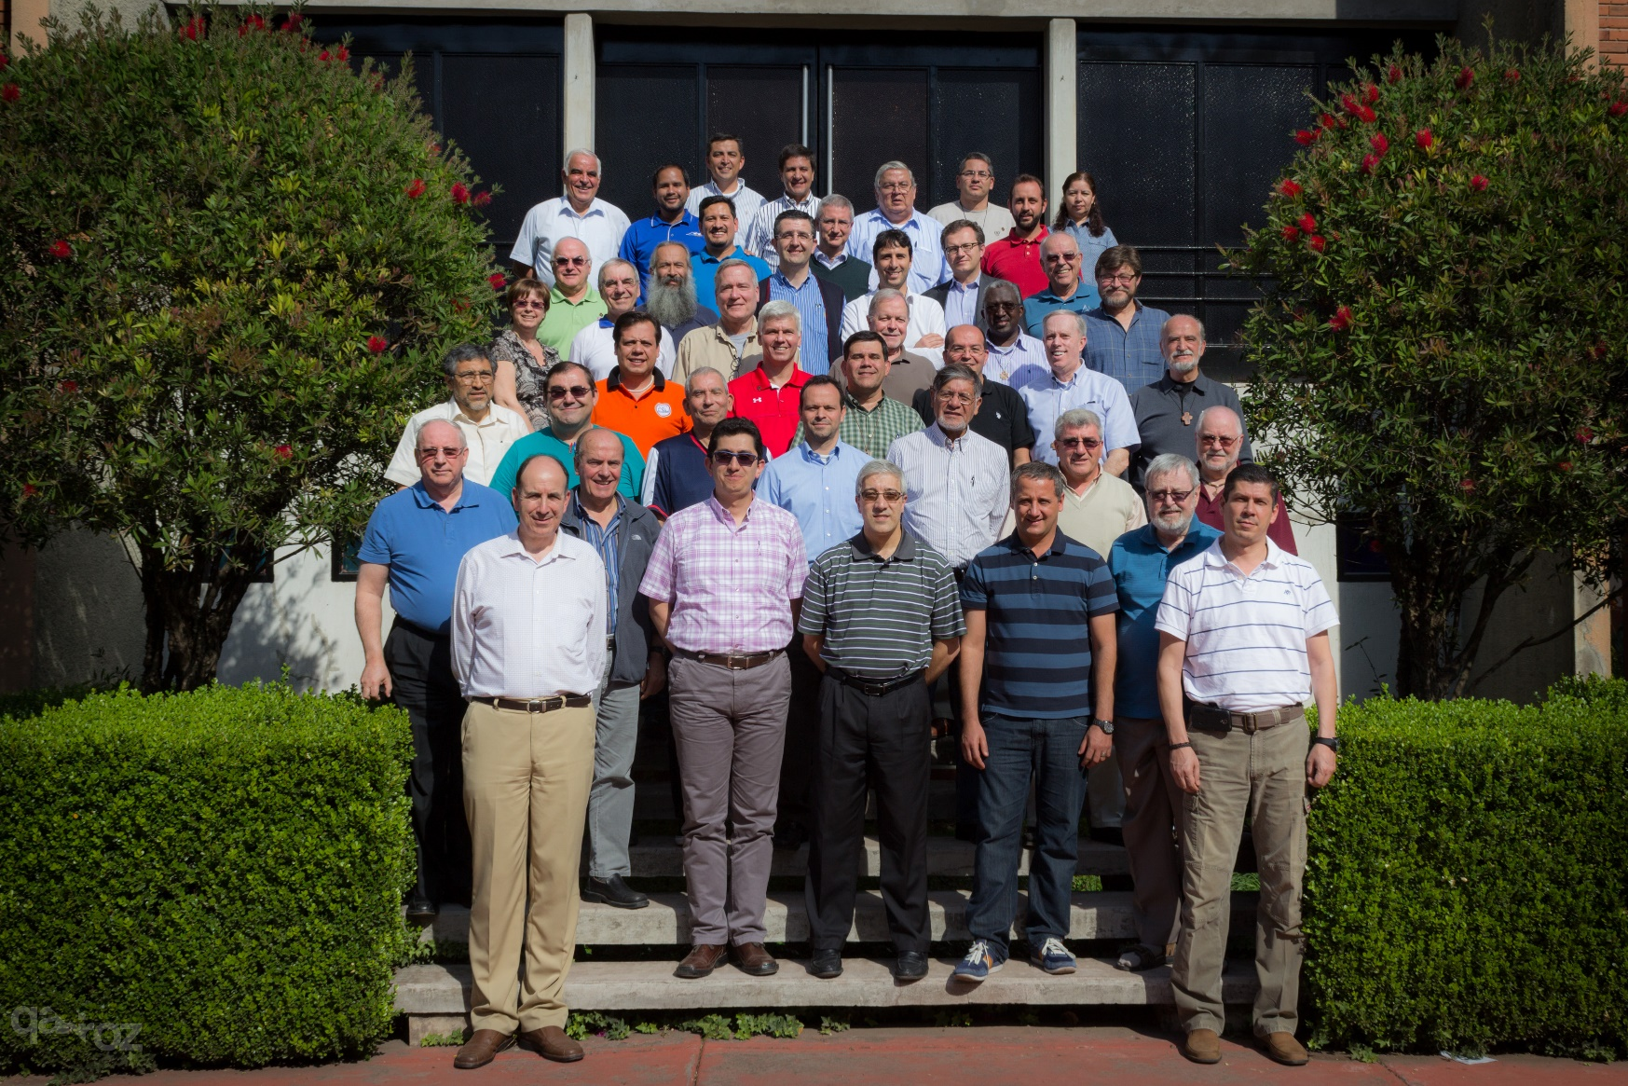
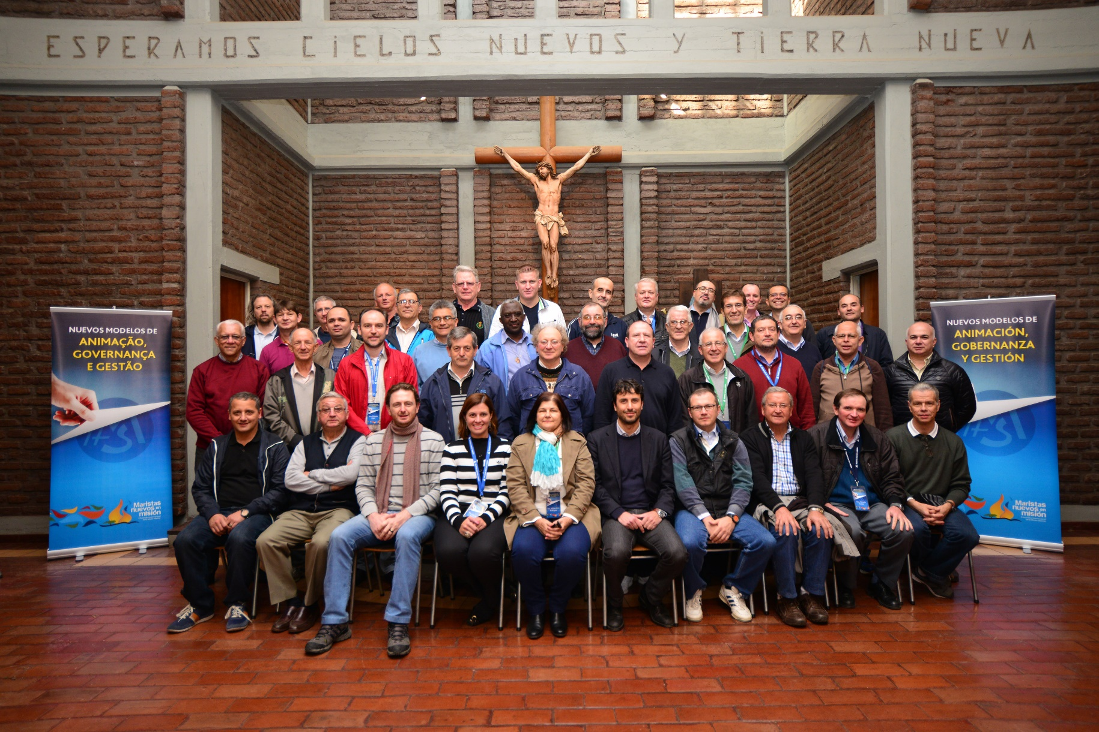

Slide 8
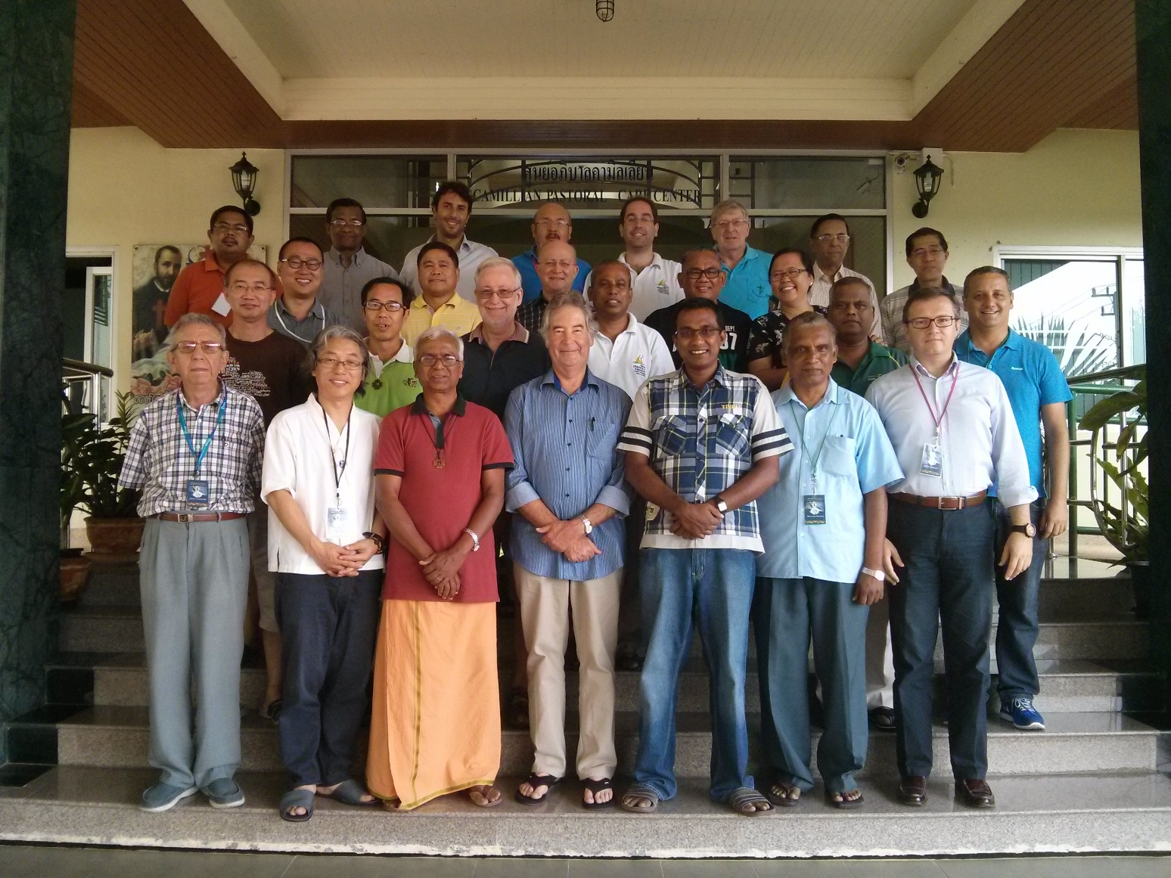
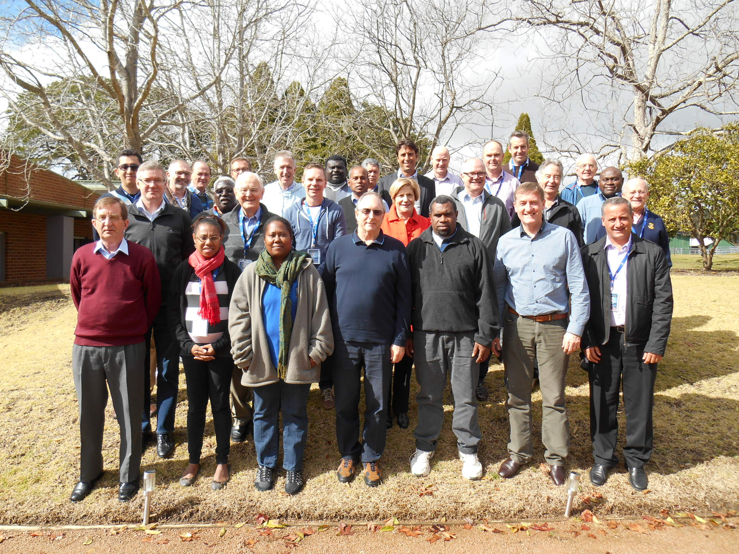

Slide 9
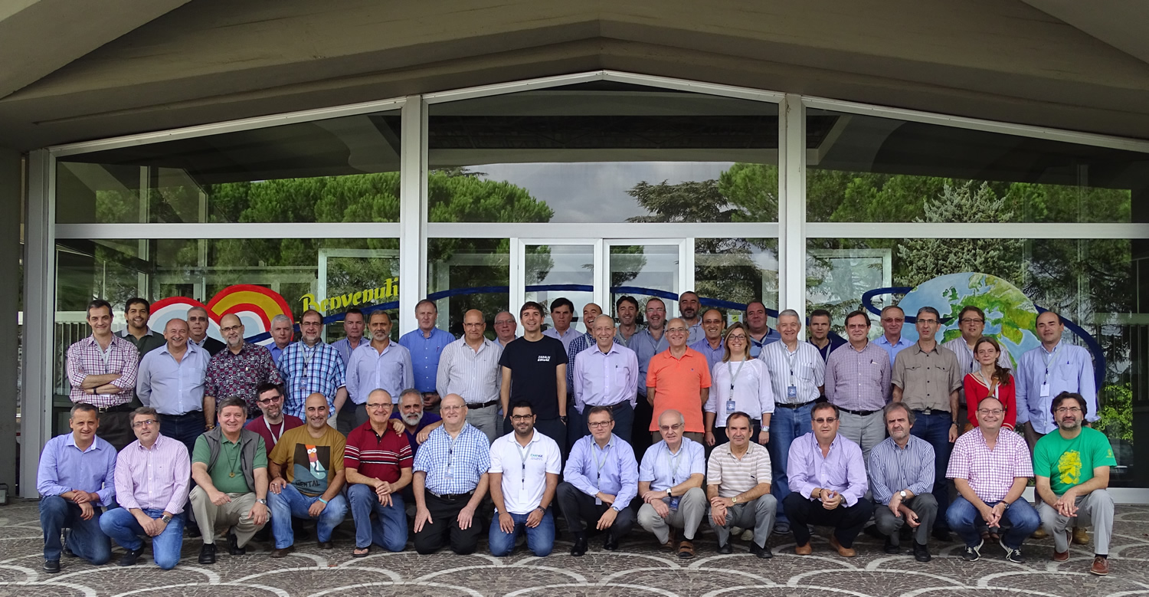
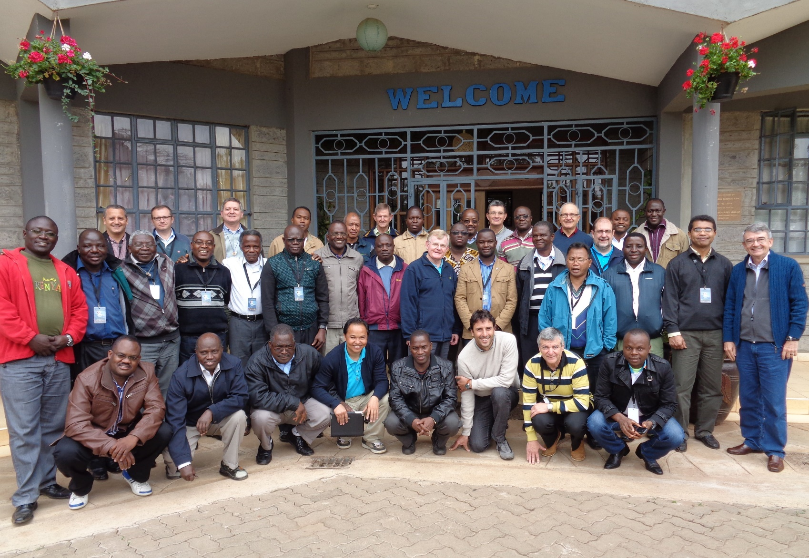

Slide 10
Brothers
Provincials | 29
Members of the Prov. Councils | 135
Other Brothers | 27
Member of central Government bodies | 12
Total Brothers | 203
Laypeople | 85
Total | 288

Slide 11
Date | Province or district
3/04/2014 | USA (including schools)
4-9/04/2014 | Mexico Central
10-12/04/2014 | Mexico Occidental
25/04/2014 | Brazil Centro Norte (including schools and UMBRASIL)
02/05/2014 | Santa Maria de los Andes
11-22 /05/ 2014 | South Asia
6/7/2014 | Canada (including retirement house and summer camp)
22/07/2014 | PACE (including MIC and MIUC)
21/08/2014 | Australia (including schools, Marist Solidarity and Marist Youth Care)
07/10/2014 | Iberica (including School of Alcalá) and CME
08-09/10/2014 | L’Hermitage (covering Barcelona and Lyon)
13/10/2014 | West Central Europe Province
30/10/2014 | District of Asia
25/11/14 | Pacific District (including school and participation to Oceania Mission Council)
December | General Administration (General Council, Secretariats and Rome personnel)

Slide 13
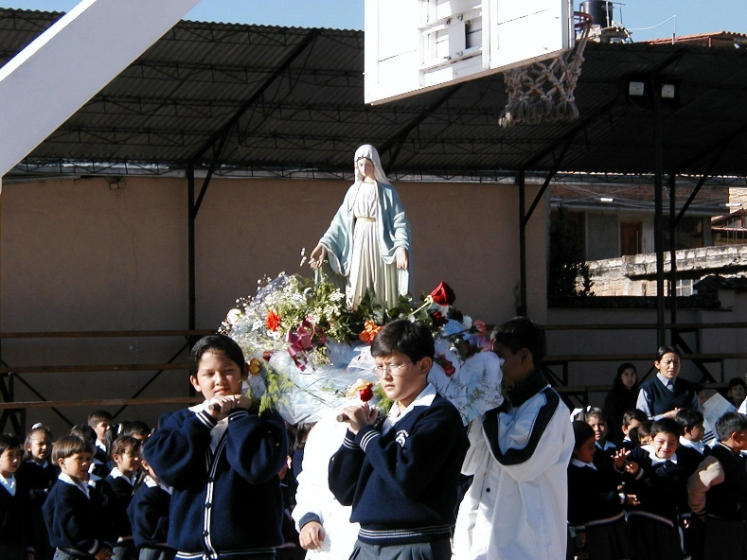
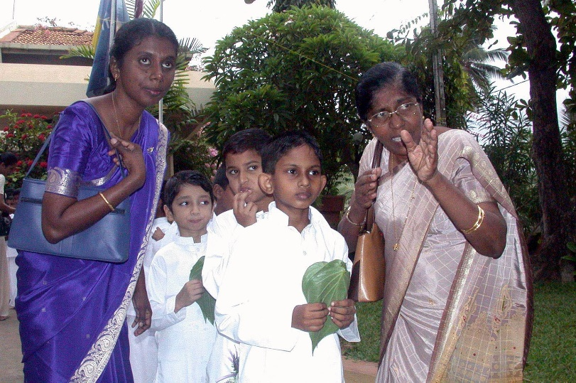
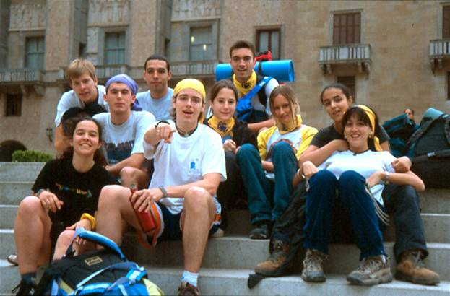
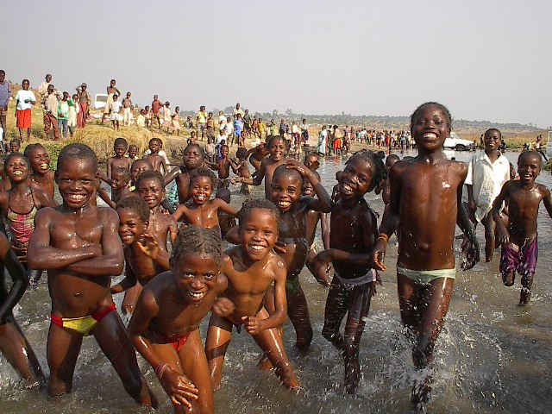
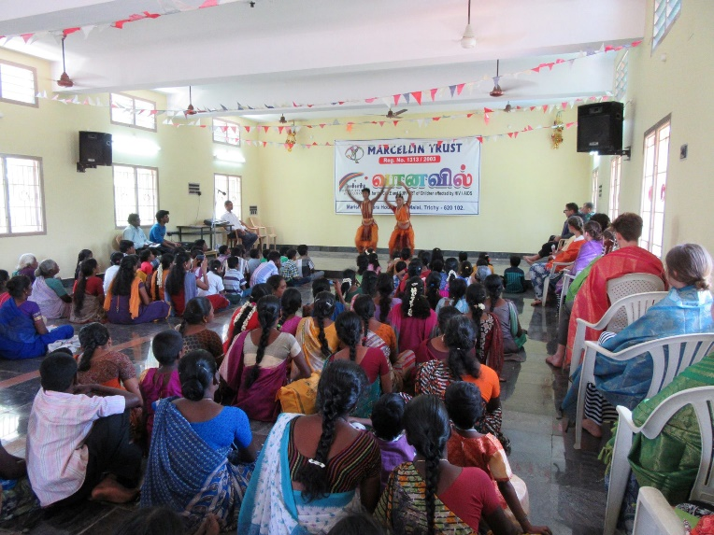
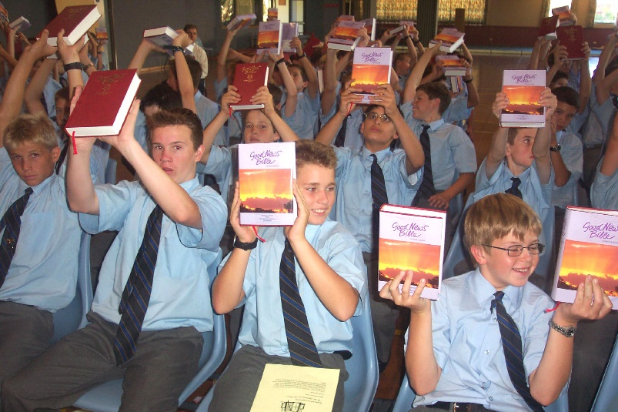
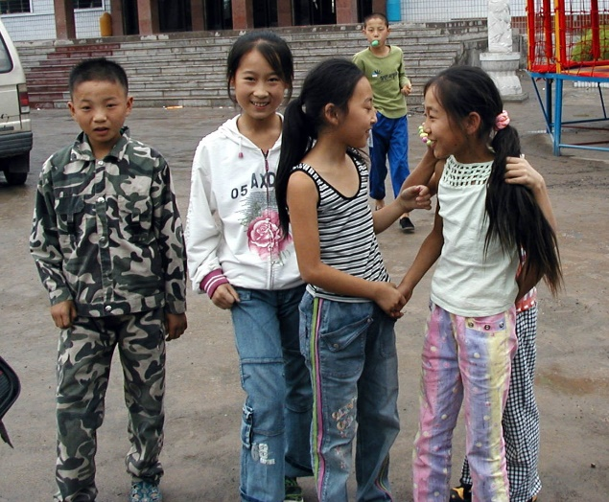
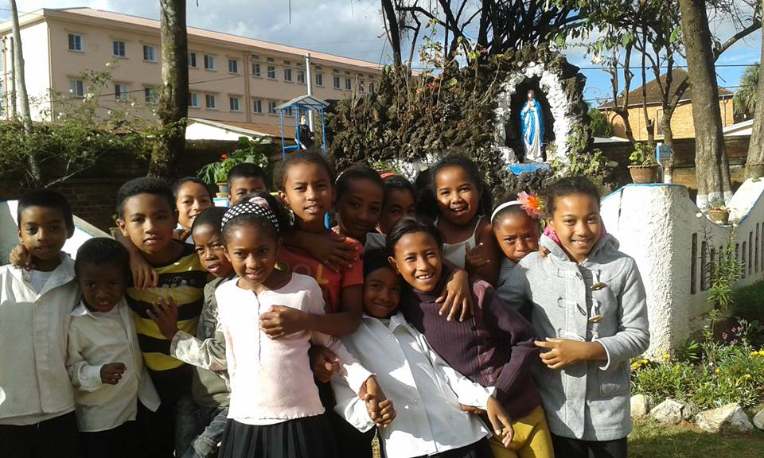
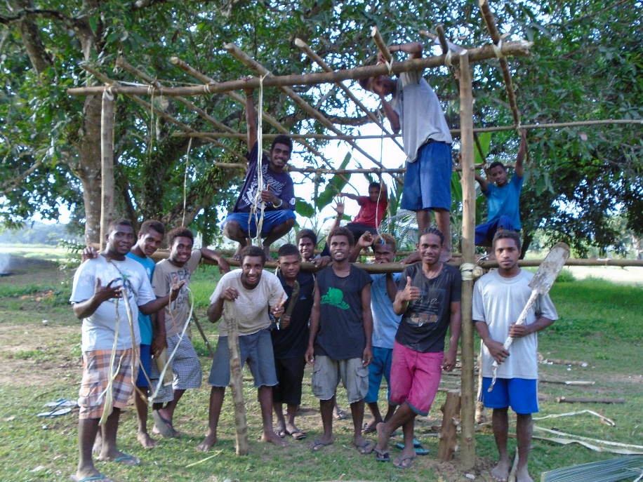
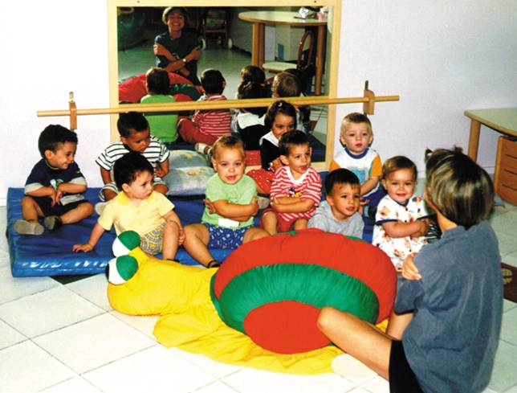
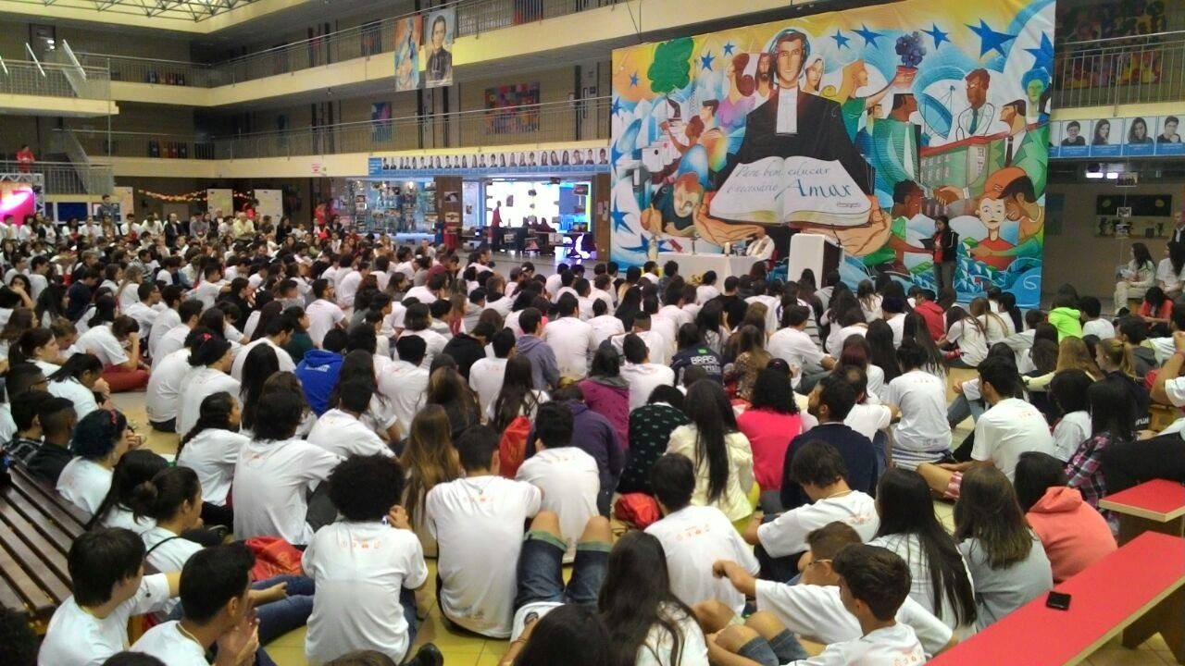
GLOBAL INSTITUTE
MARIST MISSION
LAY MARISTS

Slide 14
pROCE
GLOBAL INSTITUTE
STRUCTURES
MINDSET HEARTSET
MARIST MISSION
LAY MARISTS
PROCESSES

Slide 15
Days 2nd and 3rd
Exploring our posible future and clarifying together how it will work
GLOBAL INSTITUTE
Making it happen together
MARIST MISSION
Day 4th
LAY MARISTS
Building a global picture
Days 1st and 2nd

Slide 16
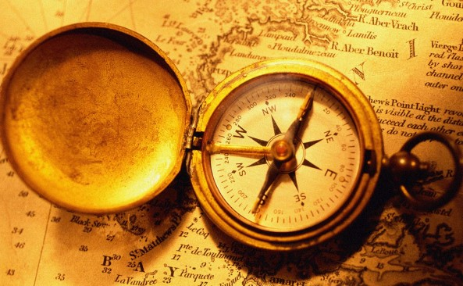

Slide 17
To enable participants to develop
consensus on a road map for new ways of animation, governance and management;
commitment to implementing the road map
to strengthen Marist Mission in the world in the years ahead.
Facilitar que los participantes puedan desarrollar
consenso en torno a una hoja de ruta sobre nuevas maneras de llevar a cabo la animación, la gobernanza y la gestión
compromiso para implementar esa hoja de ruta
para fortalecer la Misión Marista en el mundo en los próximos años.

